Slide 1
Machine Learning DSECL ZG565
Ensemble Learning
Dr. Monali Mavani
These slides are prepared by the instructor, with grateful acknowledgement of Tom Mitchell, Andrew Ng< Prof. Chetana, Prof. Vimal and many others who made their course materials freely available online.

Slide 2
Contents
Combining classifiers
Bagging
Boosting
Random Forest Algorithm
AdaBoost Algorithm

Slide 3
Getting Started
No Free Lunch Theorem: There is no algorithm that is always the most accurate
Each learning algorithm dictates a certain model that comes with a set of assumptions
Each algorithm converges to a different solution and fails under different circumstances
The best tuned learners could miss some examples and there could be other learners which works better on (may be only) those !
In the absence of a single expert ( a superior model ) , a committee (combinations of models) can do better !
A committee can work in many ways ...

Slide 4
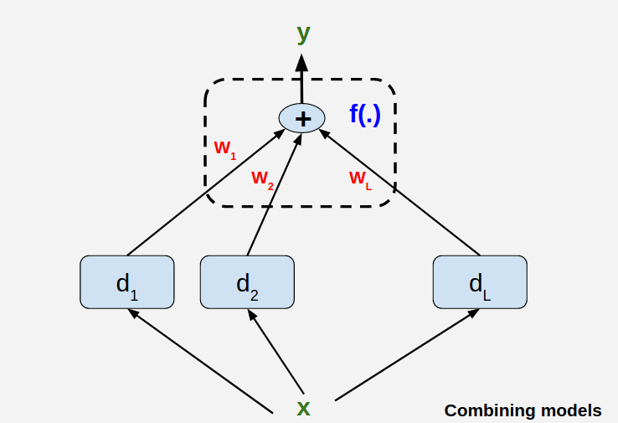
Committee of Models
Committee Members are base learners !
Major challenges dealing with this committee
Expertise of each of the members (Does it help / not?)
Combining the results from the members for better performance

Slide 5
Ensemble Methods
Ensemble methods use multiple learning algorithms to obtain better predictive performance than could be obtained from any of the constituent learning algorithms alone
Construct a set of classifiers from the training data
Predict class label of test records by combining the predictions made by multiple classifiers
Tend to reduce problems related to over-fitting of the training data.

Slide 6
General Approach

Slide 7
Issue 1 : On the members ( Base Learners )
It does not help if all learners are good/bad at roughly same thing
Need Diverse Learners

Slide 8
Issue 1 : On the members ( Base Learners )
Use Different Algorithms
Different algorithms make different assumptions
Use Different Hyperparameters,
E.g vary the structure of neural nets

Slide 9
Issue 1 : On the members ( Base Learners )
Different input representations
Uttered words + video information of speakers clips
image + text annotations
Different training sets
Draw different random samples of data
Partition data in the input space and have learners specialized in those spaces (mixture of experts)

Slide 10
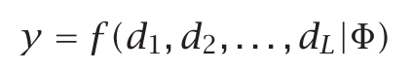
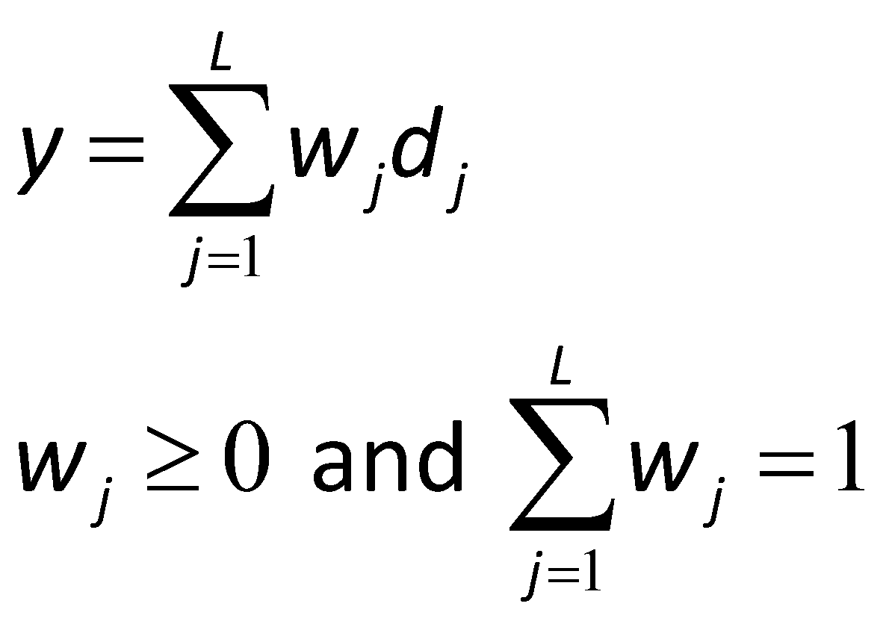
Issue -2 : Combining Results Base Learners
A Simple Combination Scheme:

Slide 11
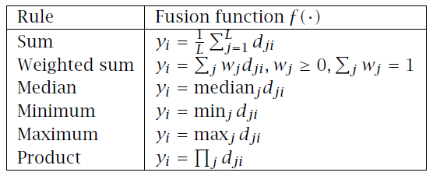
Issue -2 : Combining Results Base Learners

Slide 12
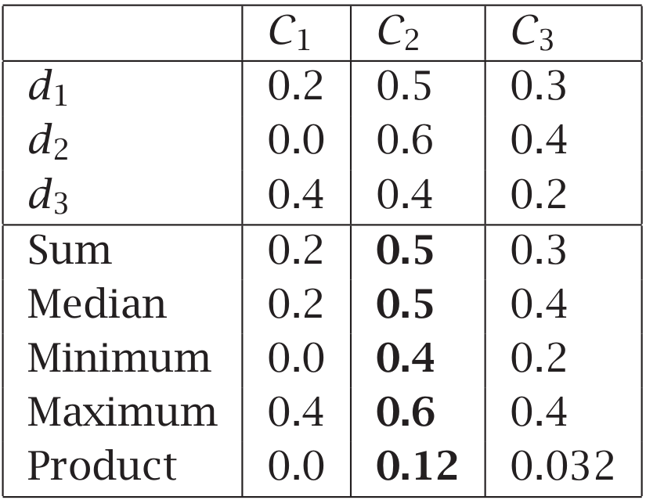
Issue -2 : Combining Results Base Learners

Slide 13
When does Ensemble work?
Ensemble classifier performs better than the base classifiers when e is smaller than 0.5
Necessary conditions for an ensemble classifier to perform better than a single classifier:
Base classifiers should be independent of each other
Base classifiers should do better than a classifier that performs random guessing

Slide 14
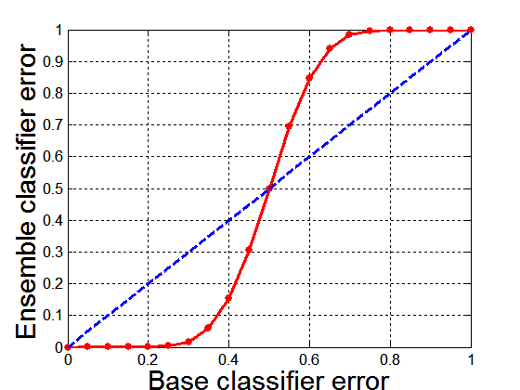
Why Ensemble Methods work?
25 base classifiers
Each classifier has error rate, ε = 0.35
If base classifiers are identical, then the ensemble will misclassify the same examples predicted incorrectly by the base classifiers depicted by dotted line
Assume errors made by classifiers are uncorrelated
Ensemble makes a wrong prediction only if base classifiers error is more than 0.5

Slide 15
Types of Ensemble Methods
Manipulate data distribution
Example: bagging, boosting
Manipulate input features
Example: random forests

Slide 16
Bagging (Bootstrap Aggregating)
Technique uses these subsets (bags) to get a fair idea of the distribution (complete set).
The size of subsets created for bagging may be less than the original set.
Bootstrapping is a sampling technique in which we create subsets of observations from the original dataset, with replacement.
When you sample with replacement, items are independent. One item does not affect the outcome of the other. You have 1/7 chance of choosing the first item and a 1/7 chance of choosing the second item.
If the two items are dependent, or linked to each other. When you choose the first item, you have a 1/7 probability of picking a item. Assuming you don’t replace the item, you only have six items to pick from. That gives you a 1/6 chance of choosing a second item.

Slide 17
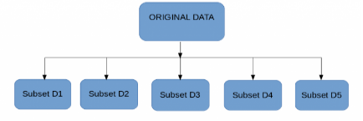
Bagging
Multiple subsets are created from the original dataset, selecting observations with replacement.
A base model (weak model) is created on each of these subsets.
The models run in parallel and are independent of each other.
The final predictions are determined by combining the predictions from all the models.

Slide 18
Bagging Example
Consider 1-dimensional data set:
Classifier is a decision stump
Decision rule: x ≤ k versus x > k
Split point k is chosen based on entropy
x ≤ k
True
False
y_{left}
y_{right}

Slide 19
Bagging Example
X < = 0.01 -> y= -1
X > 0.01 -> y= 1

Slide 20
Bagging Example

Slide 21
Bagging Example
Summary of Training sets:

Slide 22
Bagging Example
Assume test set is the same as the original data
Use majority vote to determine class of ensemble classifier
Predicted Class

Slide 23
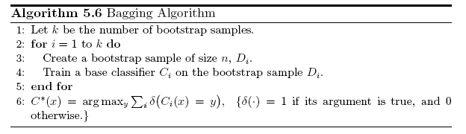
Bagging Algorithm

Slide 24
Boosting
What if a data point is incorrectly predicted by the first model, and then the next (probably all models), will combining the predictions provide better results? Such situations are taken care of by boosting.
Boosting is a sequential process, where each subsequent model attempts to correct the errors of the previous model.
The succeeding models are dependent on the previous model.

Slide 25
Boosting
An iterative procedure to adaptively change distribution of training data by focusing more on previously misclassified records
Initially, all N records are assigned equal weights
Unlike bagging, weights may change at the end of each boosting round

Slide 26
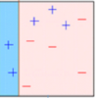
Boosting
A subset is created from the original dataset.
Initially, all data points are given equal weights.
A base model is created on this subset.
This model is used to make predictions on the whole dataset.

Slide 27
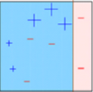
Boosting
Errors are calculated using the actual values and predicted values.
The observations which are incorrectly predicted, are given higher weights. (Here, the three misclassified blue-plus points will be given higher weights)
Another model is created and predictions are made on the dataset. (This model tries to correct the errors from the previous model)

Slide 28
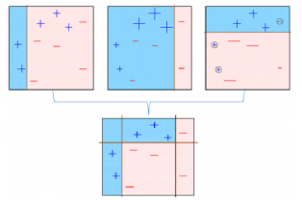
Boosting
Similarly, multiple models are created, each correcting the errors of the previous model.
The final model (strong learner) is the weighted mean of all the models (weak learners).
Individual models would not perform well on the entire dataset, but they work well for some part of the dataset. Thus, each model actually boosts the performance of the ensemble.

Slide 29
Algorithms based on Bagging and Boosting
Bagging algorithms:
Random forest
Boosting algorithms:
AdaBoost

Slide 30
Random Forest
Random Forest is ensemble machine learning algorithm that follows the bagging technique.
The base estimators in random forest are decision trees.
Random forest randomly selects a set of features which are used to decide the best split at each node of the decision tree.

Slide 31
Random Forest
Random subsets are created from the original dataset (bootstrapping).
At each node in the decision tree, only a random set of features are considered to decide the best split.
A decision tree model is fitted on each of the subsets.
The final prediction is calculated by averaging the predictions from all decision trees.

Slide 32
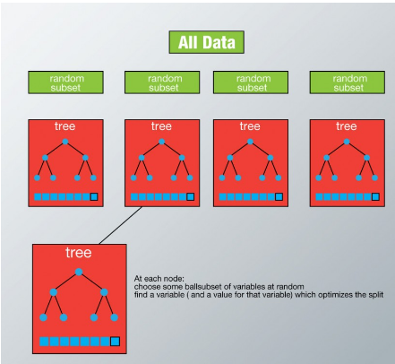

Slide 33
Advantages of Random Forest
Algorithm can solve both type of problems i.e. classification and regression
Power to handle large data set with higher dimensionality.
It can handle thousands of input variables and identify most significant variables so it is considered as one of the dimensionality reduction methods.
Model outputs Importance of variable, which can be a very handy feature (on some random data set).

Slide 34
Disadvantages of Random Forest
May over-fit data sets that are particularly noisy.
Random Forest can feel like a black box approach for statistical modelers – you have very little control on what the model does. You can at best – try different parameters and random seeds!

Slide 35
Example: Bagged Decision Trees
Draw $100$ bootstrap samples of data
Train trees on each sample → $100$ trees
Average prediction of trees on out-of-bag samples
…
Average prediction
(0.23 + 0.19 + 0.34 + 0.22 + 0.26 + … + 0.31) / # Trees = 0.24

Slide 36
Random Forests (Bagged Trees++)
Draw $1000+$bootstrap samples of data
Draw sample of available attributes at each split
Train trees on each sample/attribute set → $1000+$trees
Average prediction of trees on out-of-bag samples
…
Average prediction
(0.23 + 0.19 + 0.34 + 0.22 + 0.26 + … + 0.31) / # Trees = 0.24

Slide 37
AdaBoost
Adaptive boosting or AdaBoost is one of the simplest boosting algorithms. Usually, decision trees are used for modelling. Multiple sequential models are created, each correcting the errors from the last model.
AdaBoost assigns weights to the observations which are incorrectly predicted and the subsequent model works to predict these values correctly.

Slide 38
AdaBoost Algorithm
Initially, all observations (n) in the dataset are given equal weights (1/n).
A model is built on a subset of data.
Using this model, predictions are made on the whole dataset.
Errors are calculated by comparing the predictions and actual values.
While creating the next model, higher weights are given to the data points which were predicted incorrectly.

Slide 39
Adaboost Algorithm
Weights can be determined using the error value. For instance, higher the error more is the weight assigned to the observation.
This process is repeated until the error function does not change, or the maximum limit of the number of estimators is reached.

Slide 40
AdaBoost
Base classifiers C_{i}: C₁, C₂, …, C_{T}
Error rate:
N input samples
Importance of a classifier:
https://en.wikipedia.org/wiki/AdaBoost#Choosing_αt

Slide 41
AdaBoost: Weight Update
Weight Update:
<- Eqn:5.88
Reduce weight if correctly classified else increase
If any intermediate rounds produce error rate higher than 50%, the weights are reverted back to 1/n and the resampling procedure is repeated

Slide 42
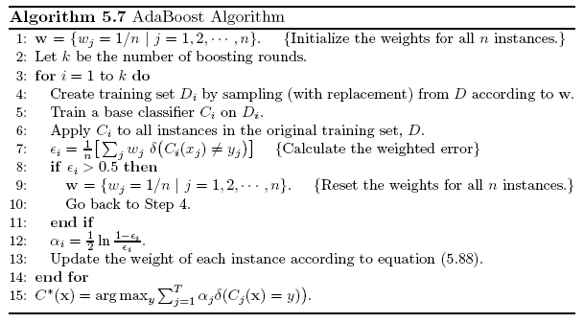
AdaBoost Algorithm

Slide 43
AdaBoost Example
Training sets for the first 3 boosting rounds:

Slide 44
AdaBoost Example
Summary:

Slide 45
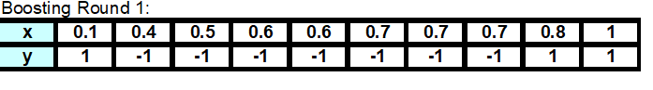
Round - 1
x | y | W1 | W2
0.1 | 1 | 0.1 | 0.5686
0.2 | 1 | 0.1 | 0.5686
0.3 | 1 | 0.1 | 0.5686
0.4 | -1 | 0.1 | 0.0176
0.5 | -1 | 0.1 | 0.0176
0.6 | -1 | 0.1 | 0.0176
0.7 | -1 | 0.1 | 0.0176
0.8 | 1 | 0.1 | 0.0176
0.9 | 1 | 0.1 | 0.0176
1 | 1 | 0.1 | 0.0176
 | ε1= | 0.0300
 | α1= | 1.7380
 |  | sum(w1-w10) | 1.83
norm w2
0.311
0.311
0.311
0.010
0.010
0.010
0.010
0.010
0.010
0.010

Slide 46
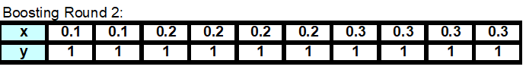
Round - 2
norm w2 | x | y | w3 | norm w3
0.311 | 0.1 | 1 | 0.019 | 0.028
0.311 | 0.2 | 1 | 0.019 | 0.028
0.311 | 0.3 | 1 | 0.019 | 0.028
0.010 | 0.4 | -1 | 0.155 | 0.228
0.010 | 0.5 | -1 | 0.155 | 0.228
0.010 | 0.6 | -1 | 0.155 | 0.228
0.010 | 0.7 | -1 | 0.155 | 0.228
0.010 | 0.8 | 1 | 0.001 | 0.001
0.010 | 0.9 | 1 | 0.001 | 0.001
0.010 | 1 | 1 | 0.001 | 0.001
0.004 | =ε2
2.778 | =α2
 |  | sum(w1-w10) | 0.679

Slide 47
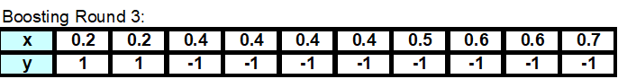
 | Round 3
norm w3 | x | y | w4 | norm w4
0.028 | 0.1 | 1 | 0.000463 | 0.002588738
0.028 | 0.2 | 1 | 0.000463 | 0.002588738
0.028 | 0.3 | 1 | 0.000463 | 0.002588738
0.228 | 0.4 | -1 | 0.003706 | 0.020736589
0.228 | 0.5 | -1 | 0.003706 | 0.020736589
0.228 | 0.6 | -1 | 0.003706 | 0.020736589
0.228 | 0.7 | -1 | 0.003706 | 0.020736589
0.001 | 0.8 | 1 | 0.054162 | 0.30309581
0.001 | 0.9 | 1 | 0.054162 | 0.30309581
0.001 | 1 | 1 | 0.054162 | 0.30309581
0.000264 | =ε3
4.119 | =α3
 |  | sum(w1-w10) | 0.178695

Slide 48
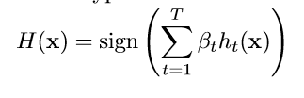
final prediction |  |  |  |  |  | Predicted class
x | y | R1 | R2 | R3 | sum | sign(sum)
0.1 | 1 | -1 | 1 | 1 | 5.159853 | 1
0.2 | 1 | -1 | 1 | 1 | 5.159853 | 1
0.3 | 1 | -1 | 1 | 1 | 5.159853 | 1
0.4 | -1 | -1 | 1 | -1 | -3.07912 | -1
0.5 | -1 | -1 | 1 | -1 | -3.07912 | -1
0.6 | -1 | -1 | 1 | -1 | -3.07912 | -1
0.7 | -1 | -1 | 1 | -1 | -3.07912 | -1
0.8 | 1 | 1 | 1 | -1 | 0.396975 | 1
0.9 | 1 | 1 | 1 | -1 | 0.396975 | 1
1 | 1 | 1 | 1 | -1 | 0.396975 | 1
α₁ | 1.7380
α₂ | 2.778
α₃ | 4.119
OR
AdaBoost error function takes into account the fact that only the sign of the final result is used, thus sum can be far larger than 1 without increasing error

Slide 49
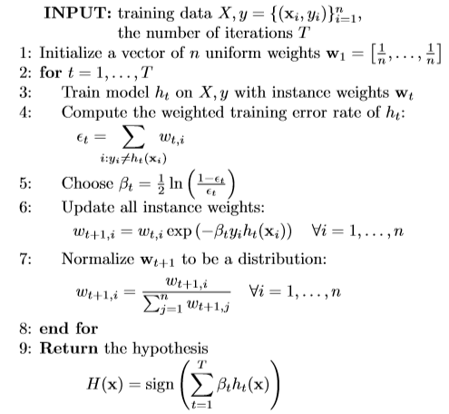
AdaBoost Algorithm
Member classifier with less error are given more weight in ﬁnal ensemble hypothesis. Final prediction is a weighted combination of each members prediction

Slide 50
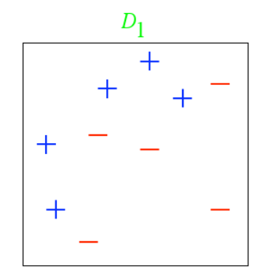
Example
From, L ́eon Bottou

Slide 51
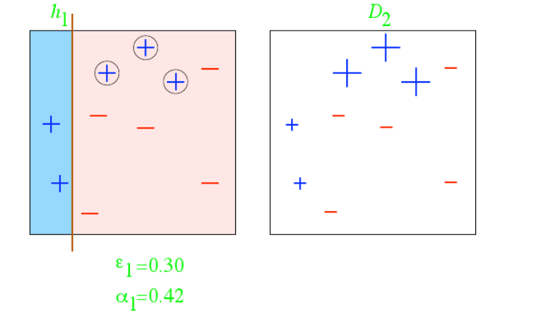
Example
From, L ́eon Bottou

Slide 52
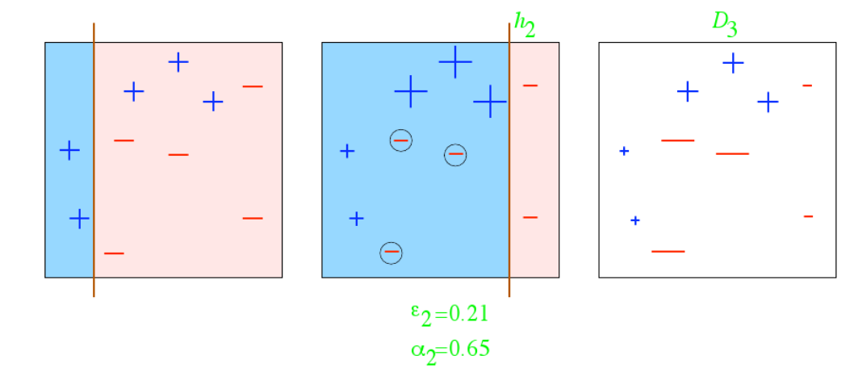
Example
From, L ́eon Bottou

Slide 53
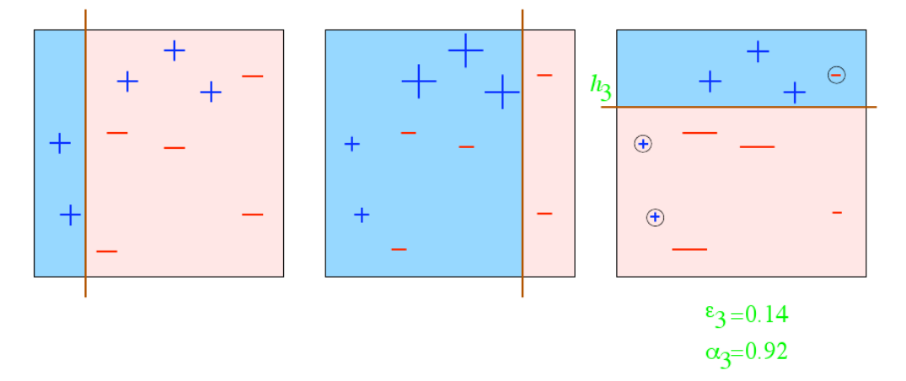
Example
From, L ́eon Bottou

Slide 54
Example
From, L ́eon Bottou

Slide 55
Example
How do we combine the results now?
From, L ́eon Bottou

Slide 56
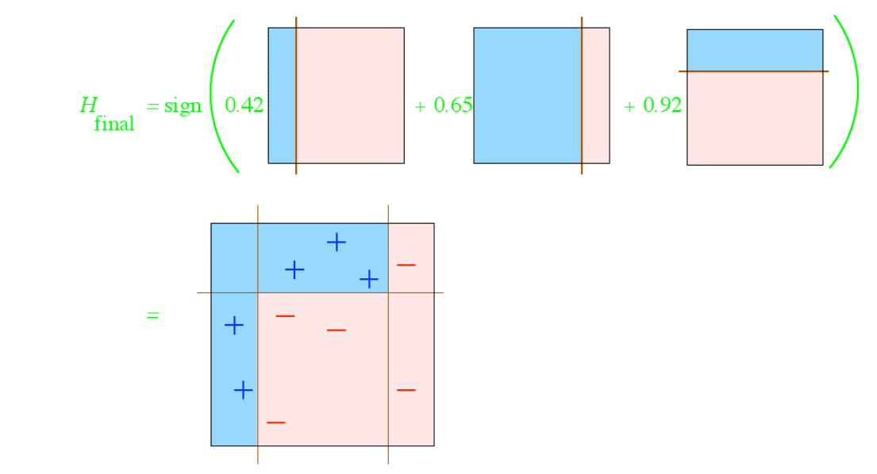
Example
How do we combine the results now?
From, L ́eon Bottou

Slide 57
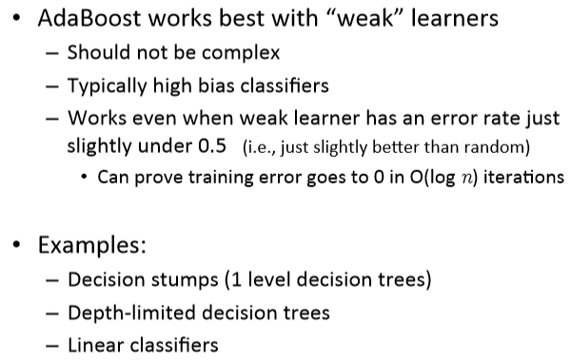
AdaBoost base learners

Slide 58
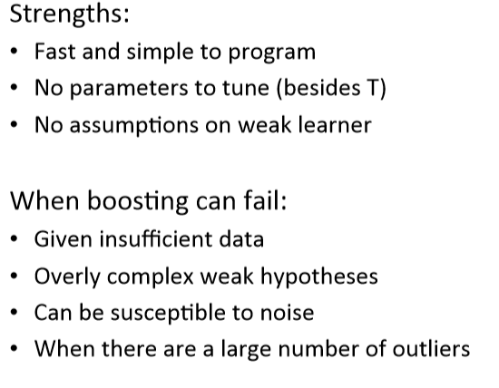
AdaBoost in practice
The model cannot be parallelized since each predictor can only be trained after the previous one has been trained and evaluated.

Slide 59
Fine Tuning Ensembles
Model combination does not always guaranteed to decrease error, unless
base-learners are diverse and accurate
Ignore poor base learners
Use accuracy as a cut-off
Introduce some pruning with which at each iteration remove poor learners / learners whose absence lead to improvement (if any)
Modify iterations to allow both additions / deletions of learners
Discarding appropriately leads to better performance

Slide 60
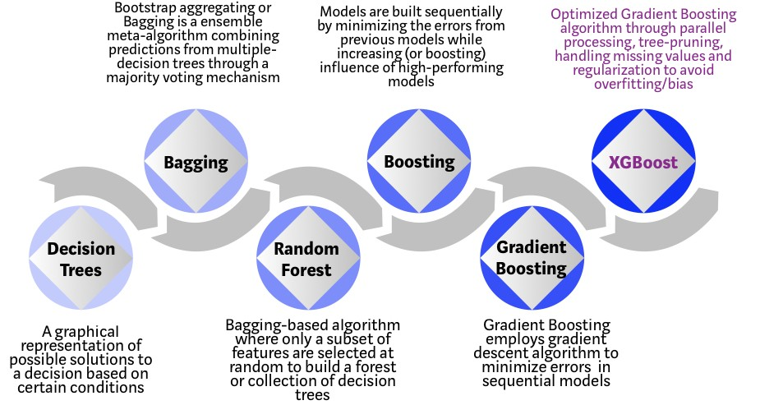
https://towardsdatascience.com/

Slide 61
Gradient Boosting
The idea of gradient boosting originated in the observation by Leo Breiman that boosting can be interpreted as an optimization algorithm on a suitable cost function
Explicit regression gradient boosting algorithms were subsequently developed
That is, algorithms that optimize a cost function over function space by iteratively choosing a function (weak hypothesis) that points in the negative gradient direction.
predictor can be any machine learning algorithm like SVM, Logistic regression, KNN , Decision tree etc. But Decision tree version of gradient boosting is much popular

Slide 62
Gradient Boosting
Gradient Boosting for Different Problems Difficulty: regression ===> classification ===> ranking
In Gradient Boosting, "shortcomings” are identified by gradients.
Recall that, in Adaboost, “shortcomings” are identified by high-weight data points.
Both high-weight data points and gradients tell us how to improve our model.

Slide 63
Gradient Boosting
You are given (x1, y1),(x2, y2), ...,(xn, yn), and the task is to fit a model F(x) to minimize square loss
There are some mistakes: F(x1) = 0.8, while y1 = 0.9, and F(x2) = 1.4 while y2 = 1.3... How can you improve this model?
Rules:
You are not allowed to remove anything from F or change any parameter in F.
You can add an additional model (regression tree) h to F, so the new prediction will be F(x) + h(x).

Slide 64
Gradient Boosting
You wish to improve the model such that
F(x1) + h(x1) = y1
F(x2) + h(x2) = y2 ...
F(xn) + h(xn) = yn
Or, equivalently, you wish
h(x1) = y1 − F(x1)
h(x2) = y2 − F(x2) ...
h(xn) = yn − F(xn)
Fit a regression tree h to data
(x1, y1 − F(x1)),(x2, y2 − F(x2)), ...,(xn, yn − F(xn))

Slide 65
Gradient Boosting
Simple solution: yi − F(xi) are called residuals. These are the parts that existing model F cannot do well.
The role of h is to compensate the shortcoming of existing model F.
If the new model F + h is still not satisfactory, we can add another regression tree...
We are improving the predictions of training data, is the procedure also useful for test data?

Slide 66
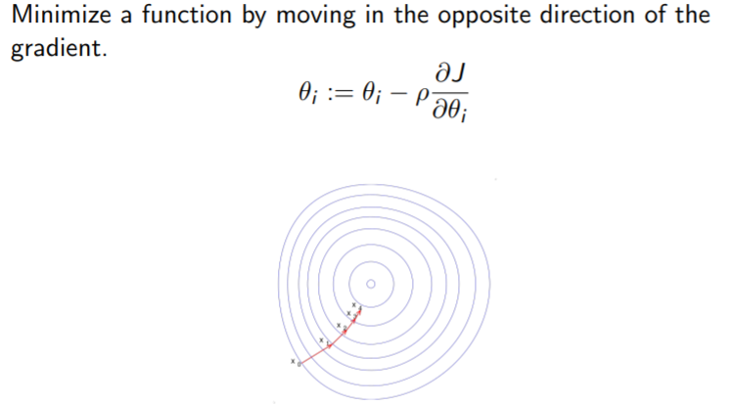
Gradient Descent

Slide 67
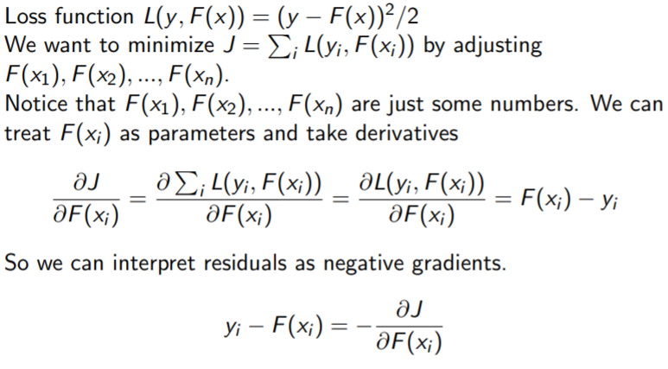
Gradient Boosting for regression

Slide 68
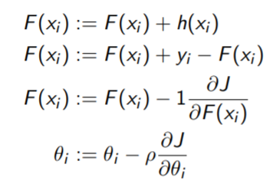
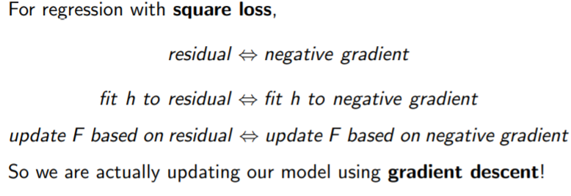

Slide 69
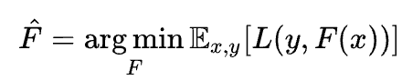
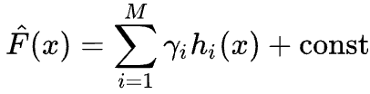
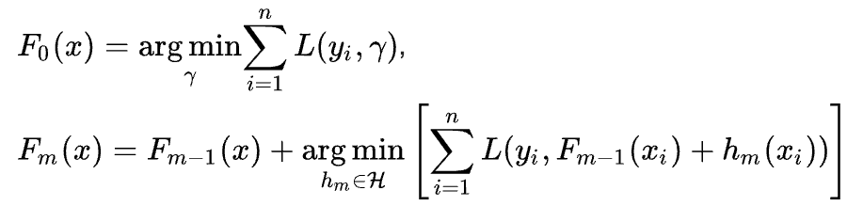
Gradient Boosting Algorithm
:
It involves three elements
A loss function to be optimized (minimizes expected value)
Approximation of F(x) in terms of weighted sum of base(weak) learners h_{i}(x) to make predictions
An additive model to minimize the loss function, starting with F₀(x) and incrementally expanding in greedy fashion

Slide 71
Why XGBoost so popular?
Speed : faster than other ensemble classifiers.
Core algorithm is parallelizable: harness the power of multi-core computers and networks of computers enabling to train on very large datasets Consistently outperforms other algorithm methods : It has shown better performance on a variety of machine learning benchmark datasets.
Wide variety of tuning parameters : cross-validation, regularization, missing values, tree parameters, etc
XGBoost (Extreme Gradient Boosting) uses the gradient boosting (GBM) framework at its core.

Slide 72
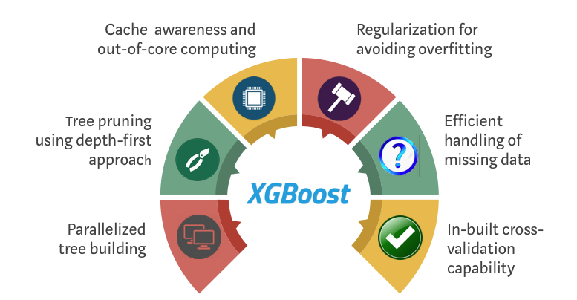
XGBoost

Slide 73
References
Introduction to Data Mining, by Pang-Ning Tan, Michael Steinbach , Vipin Kumar
Bishop - Pattern Recognition And Machine Learning - Springer 2006

Slide 74
Thank You!

